Slide 1
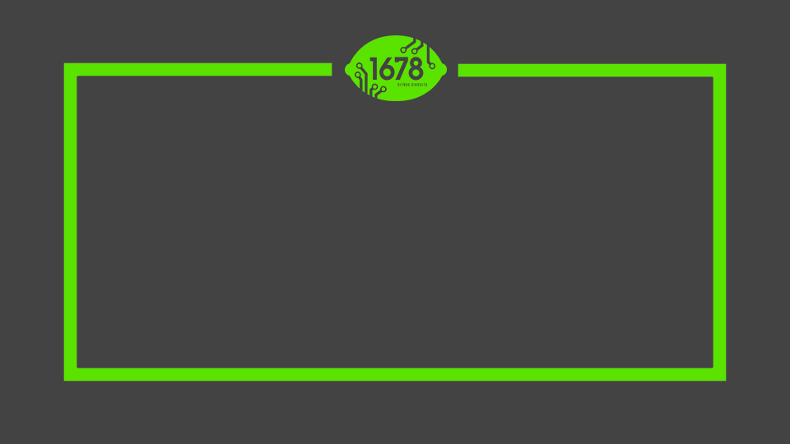
Citrus Circuits
Fall Workshop Series
Match Strategy
by Kina L. and Richard McCann

Slide 2

“Sample Quote, Sample Quote”

Slide 3
Sample Heading
Bullet Point A
Subpoint A
Bullet Point B
Subpoint B

Slide 4
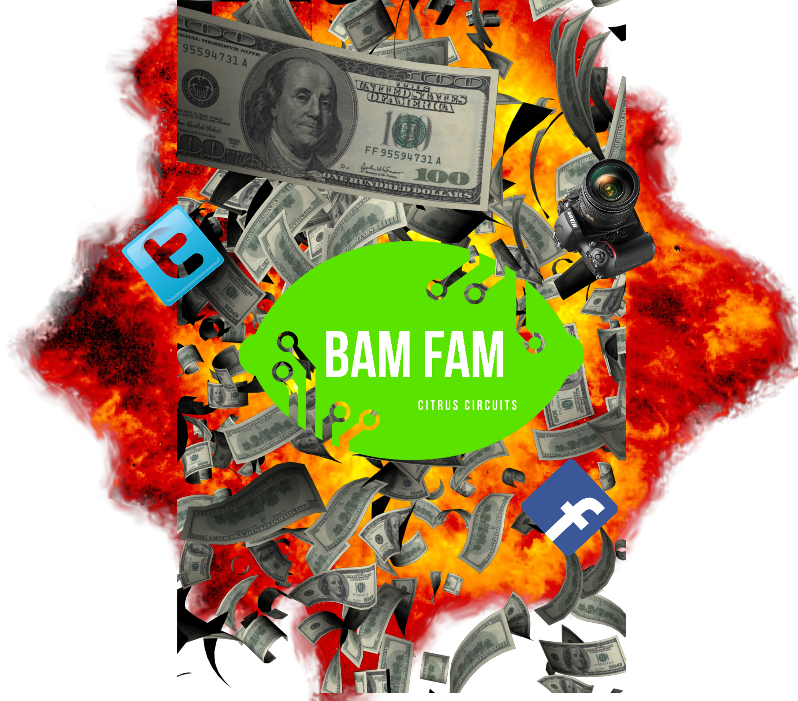
Sample Heading
Bullet Point A
Subpoint A
Bullet Point B
Subpoint B
Notes:
epic

Slide 5
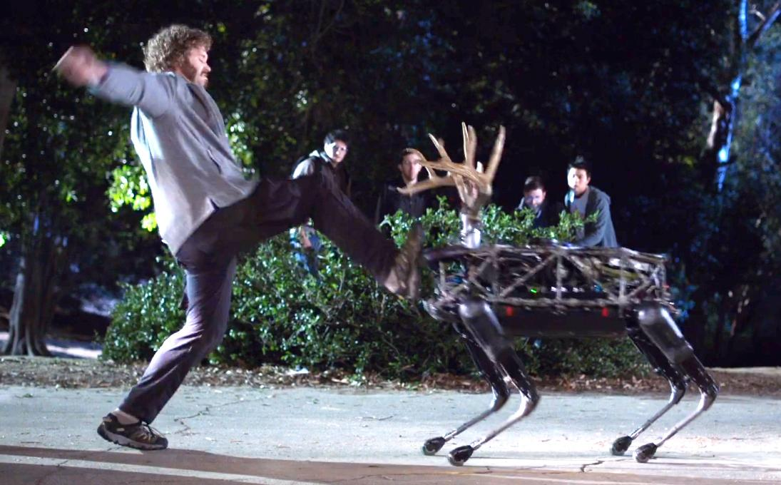
Sample Heading

Slide 6
Today’s Topics
History of our alliance choices & strategies
How we map out our match strategy

Slide 7
Who are we?
Richard McCann - Strategy & Scouting Mentor
Kina Li - Captain, Match Strategist & Hardware Design

Slide 8
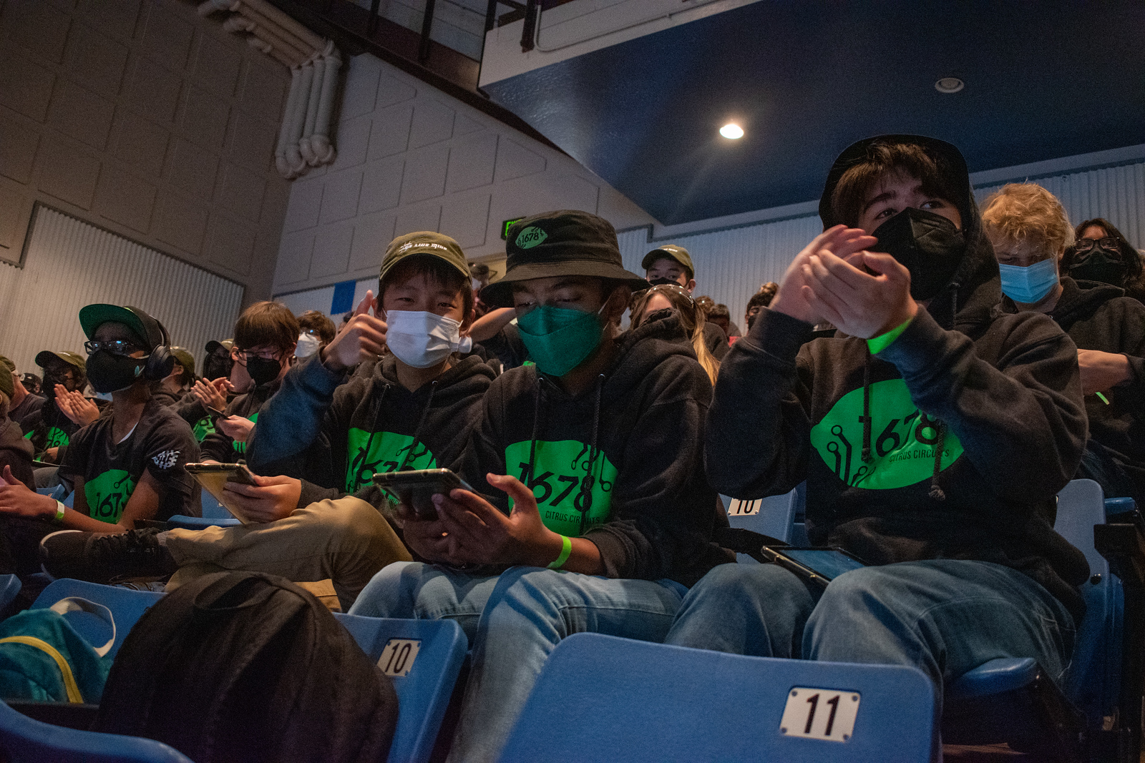
Outline
Outline
Why is Strategy Important?
Match Strategy
Preparation & Execution
Alliances That Worked
Q&A

Slide 9
Why is Strategy Important?

Slide 10
“Your robot wins matches,
your scouting wins competitions.”

Slide 11
Why are you here?
FRC has designed a unique 3v3 competition with rotating alliances
Strategies must be created for different alliance mixes
Individual robots can win single matches but can’t win consistently over a tournament
Being aware of the alliance’s capabilities will increase its likelihood of success!
Notes:
Richard will add: We have helped teams that are first time captains find scouting data and to be prepared to draft. In 2014, watched a team try to draft from the projected rankings list and vowed to avoid that at any competition that we go to.

Slide 12
Match Strategy

Slide 13
Preparation: Game Analysis
Kickoff weekend
Read the game manual!
Analyze the game
“Whats” and “Hows”
Predict strategies and designs for the season
Notes:
Richard will add: We have helped teams that are first time captains find scouting data and to be prepared to draft. In 2014, watched a team try to draft from the projected rankings list and vowed to avoid that at any competition that we go to.

Slide 14
Preparation: Scouting!
Live Match Data
Objective and subjective metrics
ex. in 2023, # of cubed & cones scored, driver awareness, auto & tele engaged
Pit Data
Pit Scouting
Drivetrain type, mechanisms, photos
SEALS
Notes:
Richard will add: We have helped teams that are first time captains find scouting data and to be prepared to draft. In 2014, watched a team try to draft from the projected rankings list and vowed to avoid that at any competition that we go to.

Slide 15
Preparation: Match Goals
Is 4 RP feasible?
Do we focus on the win or the bonus RP?
Analyze match schedule ahead of time
Identify toughest matches
Work with partners early
Notes:
Richard will add: We have helped teams that are first time captains find scouting data and to be prepared to draft. In 2014, watched a team try to draft from the projected rankings list and vowed to avoid that at any competition that we go to.

Slide 16
Execution: Match Strategy
Discuss with all teams present!
Take all individual capabilities into account
Alliance partner requests
Auto routines?
Most consistent, most compatible
Teleop roles
Strongest scorers, defense?
Endgame
Speed, compatibility, scoring vs. endgame?
Notes:
Richard will add: We have helped teams that are first time captains find scouting data and to be prepared to draft. In 2014, watched a team try to draft from the projected rankings list and vowed to avoid that at any competition that we go to.

Slide 17
Execution: Match Strategy
Our Alliance vs. Opposing Alliance
Strengths, weaknesses, predicted roles & actions
Early season/during quals vs. late season/during elims
Less defense, more offense, focus on RPs
More defense, more complex strategies
Notes:
Richard will add: We have helped teams that are first time captains find scouting data and to be prepared to draft. In 2014, watched a team try to draft from the projected rankings list and vowed to avoid that at any competition that we go to.

Slide 18
Execution: Match Strategist
Specific role at competition, separate from drive team
Advises drive coach
Meets with alliance partners
Clipboard/Field Layout
Make the drive team's job easy!
Notes:
Richard will add: We have helped teams that are first time captains find scouting data and to be prepared to draft. In 2014, watched a team try to draft from the projected rankings list and vowed to avoid that at any competition that we go to.

Slide 19
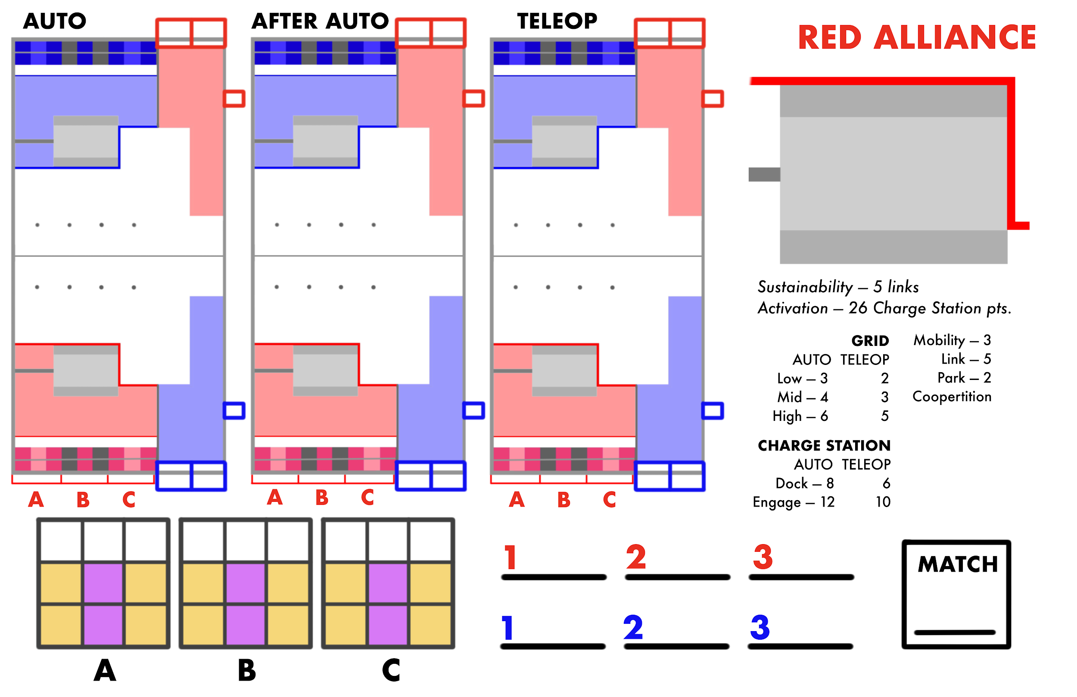
Execution: Match Strategist
Notes:
Richard will add: We have helped teams that are first time captains find scouting data and to be prepared to draft. In 2014, watched a team try to draft from the projected rankings list and vowed to avoid that at any competition that we go to.

Slide 20
Alliances That Worked

Slide 21
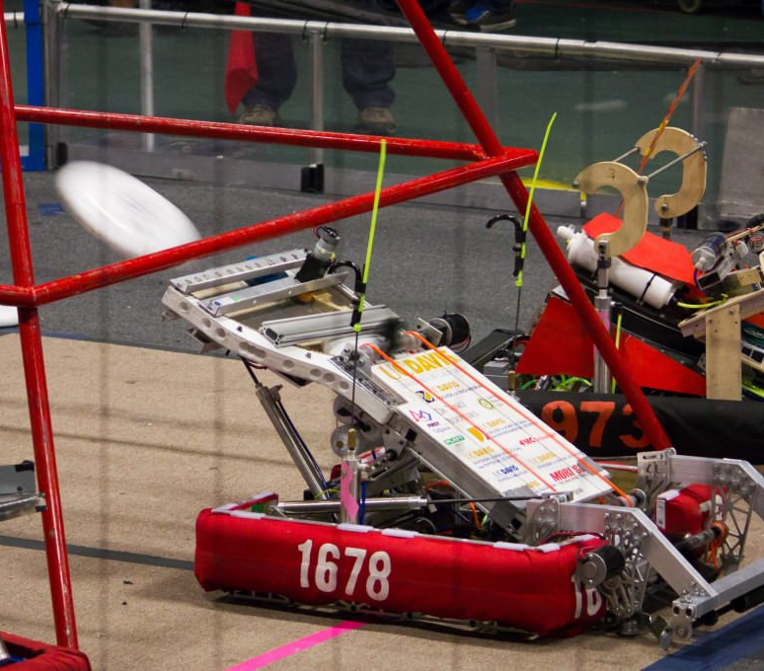
What changed for 1678?
Had won Sac Regional in 2010-2012, but hadn’t succeeded at Champs
New electronic scouting system in 2013
Switched from focusing on our robot to our ALLIANCE!

Slide 22
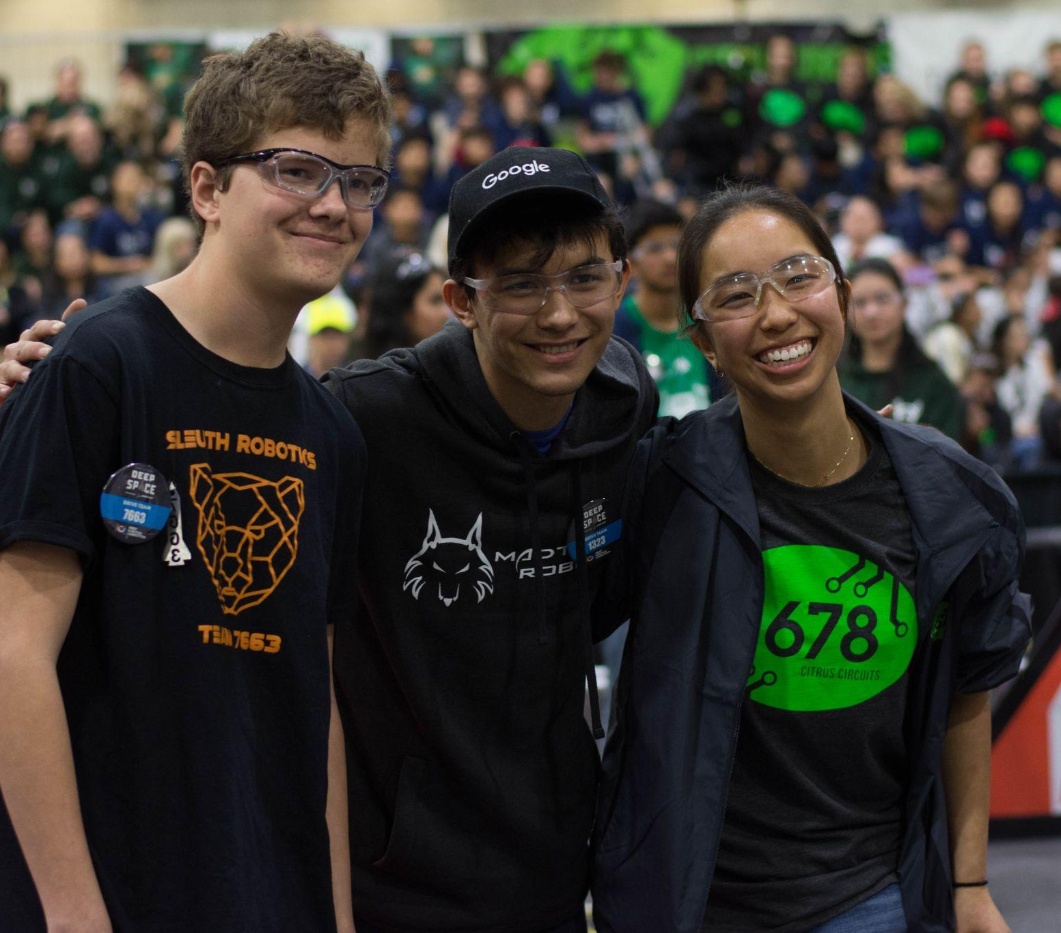
Alliance Strategy Begins at Kickoff
Tasks are assigned to alliance mates
Robot capabilities dependent on other bots

Slide 23
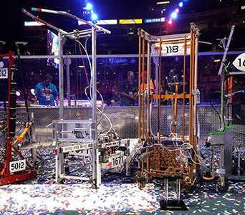
General Rules
Make your alliance mates look good
Be aware
Take advantage of luck

Slide 24
Past Examples

Slide 25
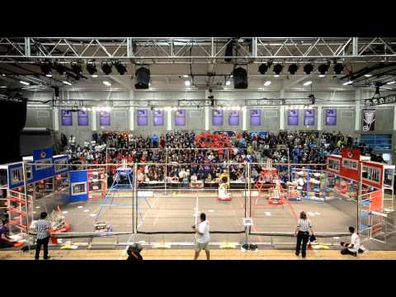
2013: Protect your most valuable scorer

Slide 26
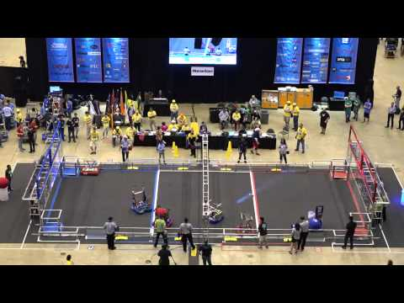
2014: Everyone contributes

Slide 27
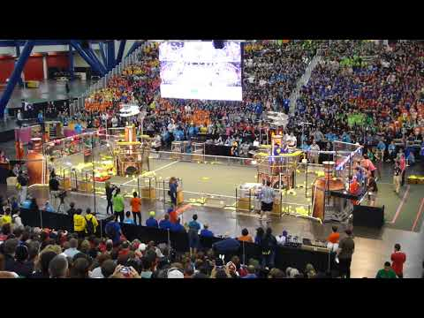
2017: Understand opponents’ vulnerabilities

Slide 28
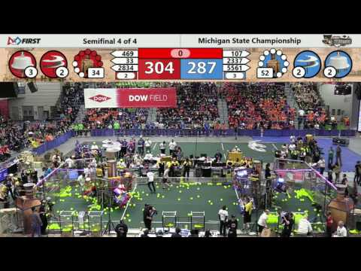
2017: Think unconventionally

Slide 29
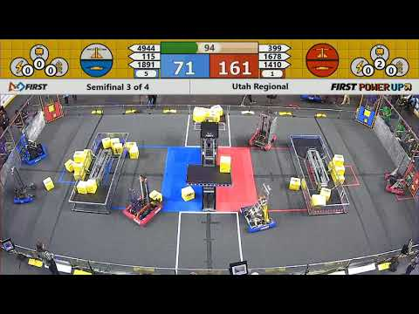
2018: Clear roles

Slide 30
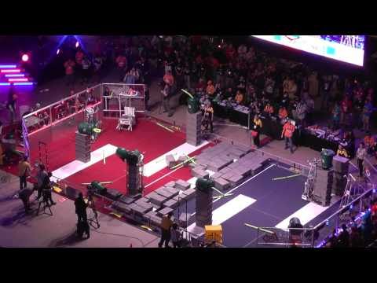
2015: And some luck!

Slide 31

Citrus Circuits
Fall Workshop Series
Find us at strategy@citruscircuits.org
Give us feedback through the QR!
Thank you!

